Slide 1

MLOps
Model improvement with MLflow
Notes:
The following slides were presented on November 25, 2021 by Gábor Tanács
at a meetup session organized on the Community-Z platform, entitled: "MLOps - Model improvement with MLflow“
https://community-z.com/events/model_improvement_with_ml_flow/
MLOps. What does it really mean?
As ML developers, why do we need it?
The presentation wants to highlight what is MLOps, why it is important in machine learning development and how MLflow can help with that.

Slide 2


gabor.tanacs@yahoo.com
www.linkedin.com/in/gabortanacs/
github.com/1amG4bor/mlflow-for-model-improvement
Gábor Tanács
Software Engineer
Notes:
The presenter is Gabor Tanacs, Software Engineer at EPAM Systems (Hungary)
Working in backend and frontend role with various programming languages and frameworks.
Active developer and contributor in an internal Python and ML community at EPAM.

Slide 3
Agenda
Machine Learning pipeline
01
How to get from an idea through raw data to a working model in production
What MLflow provides
02
Solution for analytics, packaging and deployment
Using and customizing
03
How to use Mlflow to analyze models
Overview of the model customization options
Summary and Q&A
04

Slide 4
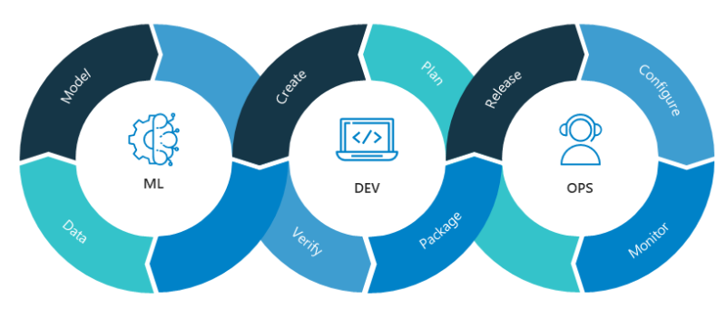
MLOps - Machine Learning Operations
Wikipedia
“MLOps is a set of practices that aims to deploy and maintain machine learning models in production reliably and efficiently.”
Notes:
The expression of MLOps (Machine Learning Operations ) is built from ML and DevOps.
While ML is stands for machine learning, DevOps is made up of the terms software development and IT operations
MLOps is a practice that manages a complete, end-to-end machine learning development process.
It is used for designing, building and deploying ML-based software that can be reproduced, tested and improved.
The process involves the collaboration of Data Engineer, Data Scientists, ML Engineers, and DevOps to build and deploy ML algorithms in automated way.
But how does it look like in the real world?
First of all, let's see the steps of a typical ML pipeline

Slide 5


Problem definition
Driving Assistant Service
Traffic-sign recognition
Fast drive warning
Indicate populated area
Pedestrian crossing warning
Notes:
The first step is to define and analyze the problem.
In our case, let's imagine that the customer wants a system that helps the people on the road to drive safer.
Let's build a "Driver Assistance Service" with features such as:
traffic sign recognition, fast drive warning, populated area signaling, pedestrian cross warning, blind-spot monitoring, etc.
We could make a HUD display system with sound alerts and more, but the first step is to create a “Traffic sign recognition model”.

Slide 6
Machine Learning Pipeline
Deployment
Once the desired model is produced, it is typically exposed via some kind of API to make it available for internal/external usage
Modelling
Create and train the model, assess the performance on unseen data to validate its real accuracy
Data Ingestion
Identify and gather the data, prepare it to be ready to use then split the dataset
Problem Definition
Examine and analyze the business problem to get to know the issue and find the proper way to solve that
Trained model(s)
Datasets for the model
Definition of input & output
Notes:
Problem definition We need to get to know deeply the issue to be able to analyze it, make suggestion and find the proper way to solve that.
Data Ingestion /Data pipeline Includes the data sourcing, data preparation, and data segregation steps to get proper datasets both for training and testing.
Modelling Plan, create and train our model, then validate it to find the model the performs best.
Deployment Deploying the final model and continuously monitoring to observe how it behaved in the real world and calibrated accordingly.

Slide 7
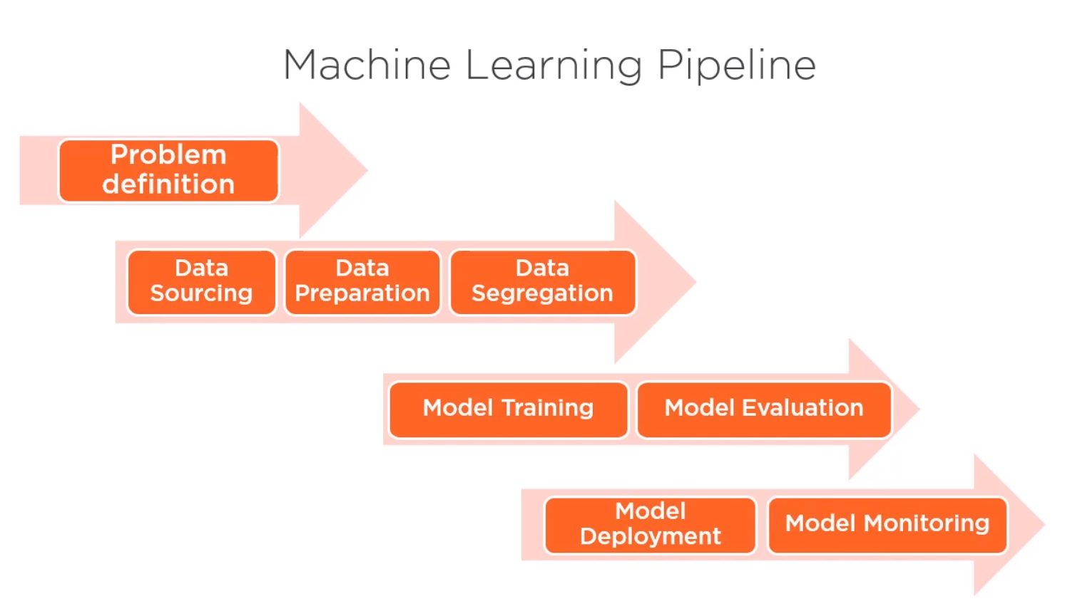

Data Ingestion – Data pipeline
Notes:
Data Sourcing (Collecting) - Identify and gather the data and feed it into our pipeline.
REST endpoint, file integration, SQL Table, Sensor output,...
In our case it will be the GTSRB - German Traffic Sign Recognition Benchmark
Data Preparation - Process the raw and unstructured data.
Filling missing values
Removing duplicate records, dropping unnecessary attributes
Labeling images
Normalizing flows/outliers in data
Data augmentation can help to fine-tune our model to perform better in edge cases, such as: poor visibility conditions
Our dataset is prepared to use!
Data Segregation - Split our data to subsets of training-set and testing-set
Shuffle,
Split to train-validation-test set,
K-fold cross validation can help to work with small dataset

Slide 8

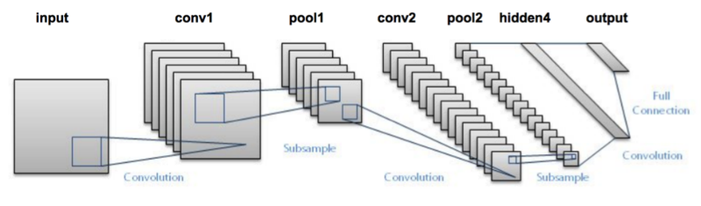
Modelling
Notes:
Model Training – It is the core of the pipeline. We use the training/validation subsets to let the ML algorithm recognize the patterns in it.
If we want to find the best perform model we need a configurable model:
Number of layers
Size of layers
Proper hyperparameters (external parameter): epoch, batch-size, activation function, learning rate, loss function, optimizer, kernel/filter/pooling size
Model Evaluation - Assess the performance of the model using the testing subset of data to understand how accurate the prediction is.
Accuracy and loss
Cumulative and class-based accuracy

Slide 9

Deployment
Notes:
Model Deployment - Once the chosen model is produced, it is typically exposed via some kind of API and embedded in decision-making frameworks as a part of an analytics solution.
Model Monitoring - The model is continuously monitored to observe how it behaved in the real world and calibrated accordingly. New data is collected to incrementally improve it.
You might think that it's quite complex where you have to pay attention to a lot of things.
It’s true, but how can we achieve all this? By what tool is this possible?
I chose MLflow, but why?

Slide 10
MLflow components
Tracking
Record and query experiments code, data, config, and results
Model registry
Store, annotate, discover, and manage models in a central repository
MLflow is an open source platform to manage the ML lifecycle
Experimentation
Reproducibility
Deployment
Central model registry
Projects
Package data science code in a format to reproduce runs on any platform
Models
Deploy machine learning models in diverse serving environments
Notes:
Experiment to log and revisit our metrics, params, models, etc.
Reproducibility to run our experiments on other machines even in different OS that helps the collaboration.
Deployment that provides many options to use our model in several different environments.
Central model registry which helps to manage our models and its versions and stages.
Component/modules of MLflow:
Tracking: API and UI for logging parameters, tags, metrics, artifacts, models and metadata when running your machine learning code and for later visualizing the results.
Model Registry: Providing a central model store to collaboratively manage the full lifecycle of an MLflow Model, including model versioning, stage transitions, and annotations
Central repository: Unique-named registered models collaboratively managed across data teams. They can be identified via their name, description, tags, version, etc. Enterprise features have role-based access control.
Model registry workflow: UI or API
Model versioning: allow multiple version of the same model in different stages
Model stages: allow stage transition – none, staging, production, archived
MLflow Projects: Packaging ML code in a reusable, reproducible form in order to share with other data scientists, run on any platform or transfer to production.
MLflow Models: Managing and deploying models from a variety of ML libraries to a variety of model serving and inference platforms. To Docker, AWS Sagemaker, Azure ML, Apache Spark, etc. Or plugins maintained by the community - RedisAI, TorchServe, etc. Or even on custom target – with the help of deployment API & CLI

Slide 11
How to Start
pip install mlflow
…
mlflow ui
Notes:
It all seems rather complex, so how do we get started?

Slide 12
Screenshots about
The online presentation

Slide 13
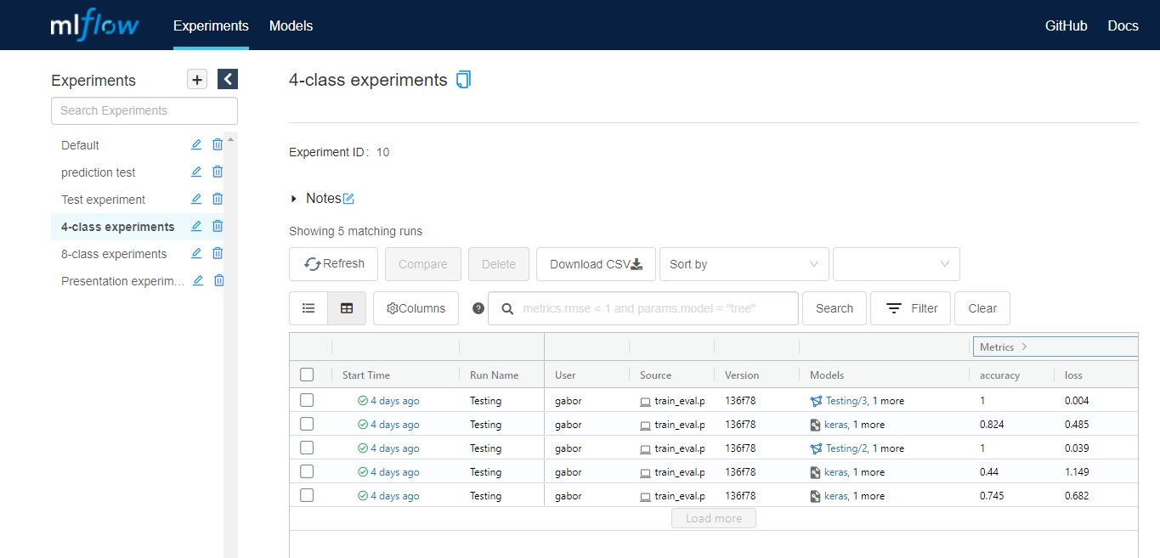
Tracking UI of MLflow - Experiments
Filtering options for experiments
List of experiment groups
Runs/experiments in a group
Notes:
Experiments can be grouped by setting the experiment name, otherwise they will be recorded into the ‘Default’ group
Runs are grouped into experiment groups and they can be compared with each others
Runs can be filtered in many ways to find easily that you need
Filter by state and/or linked model
Search by query, such as:
attributes.status = "FAILED"
metrics.val_accuracy > 0.8
params.HP_epochs = "25"

Slide 14
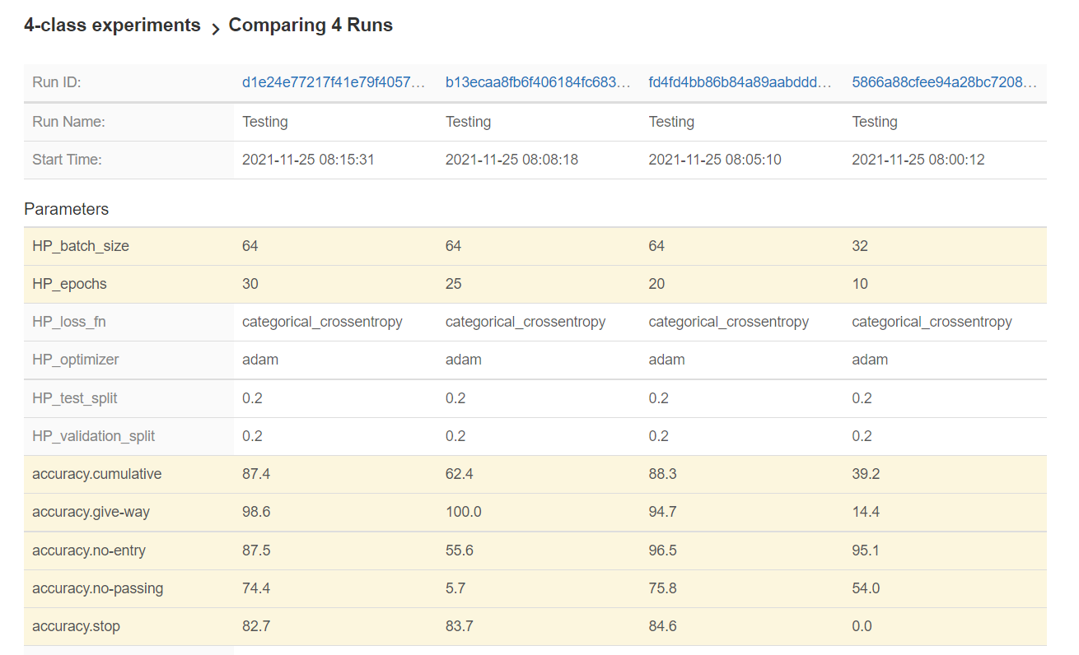
Compare experiments
Link for each run in comparison view
Parameter differences are emphasized
Easy to compare different runs to find which perform the best
Notes:
The comparison view give the ability to compare runs in an efficient way with particular attention to the comparison of parameters and metrics.
The desired model is easily accessible via the provided link.

Slide 15
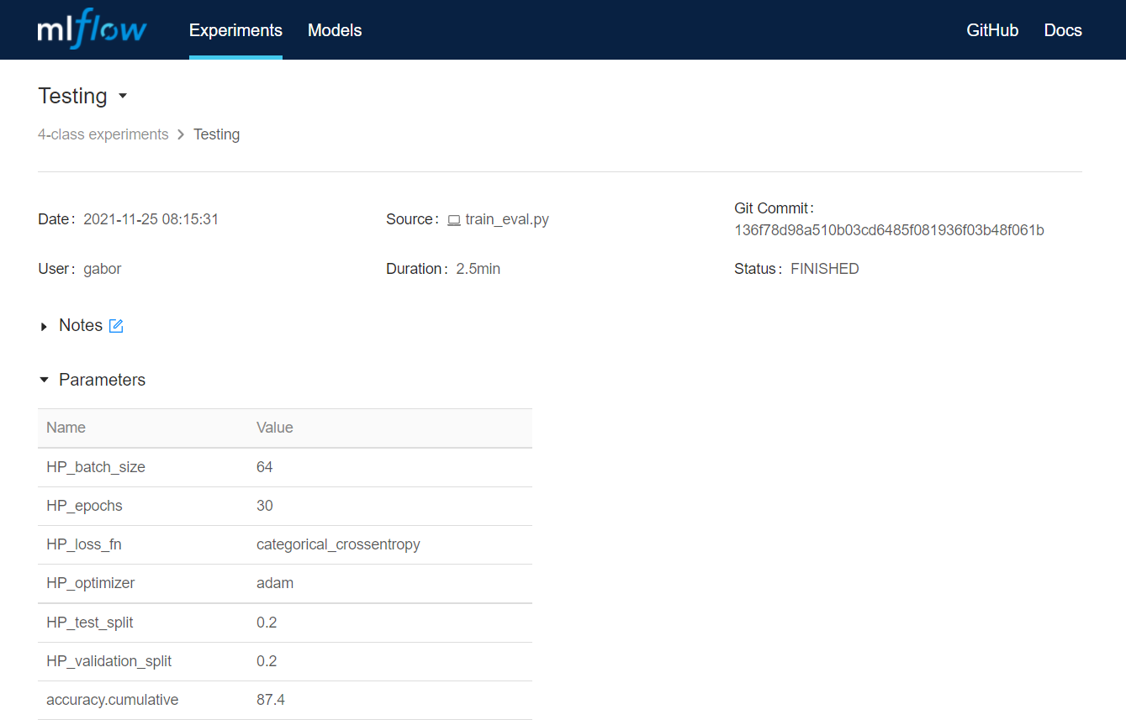
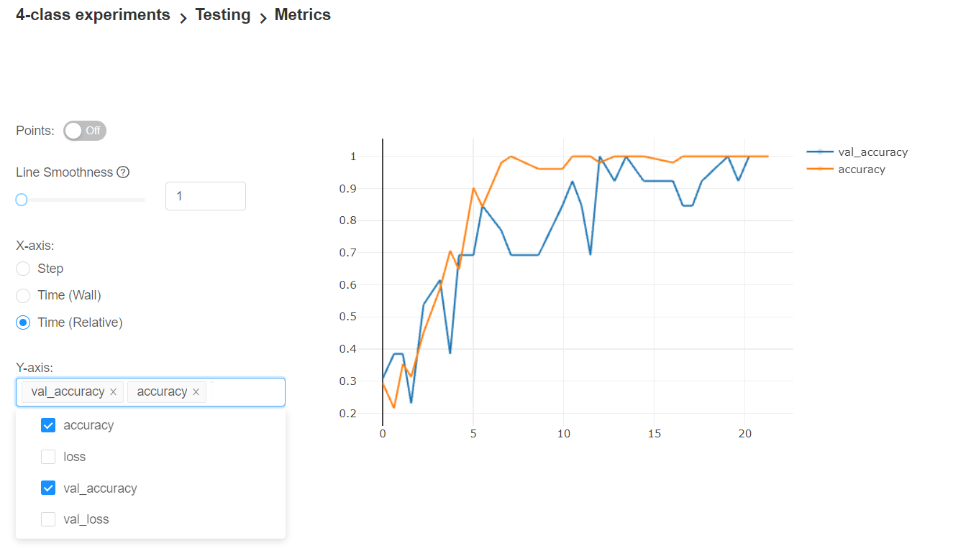
Experiment details – parameters & metric board

Slide 16
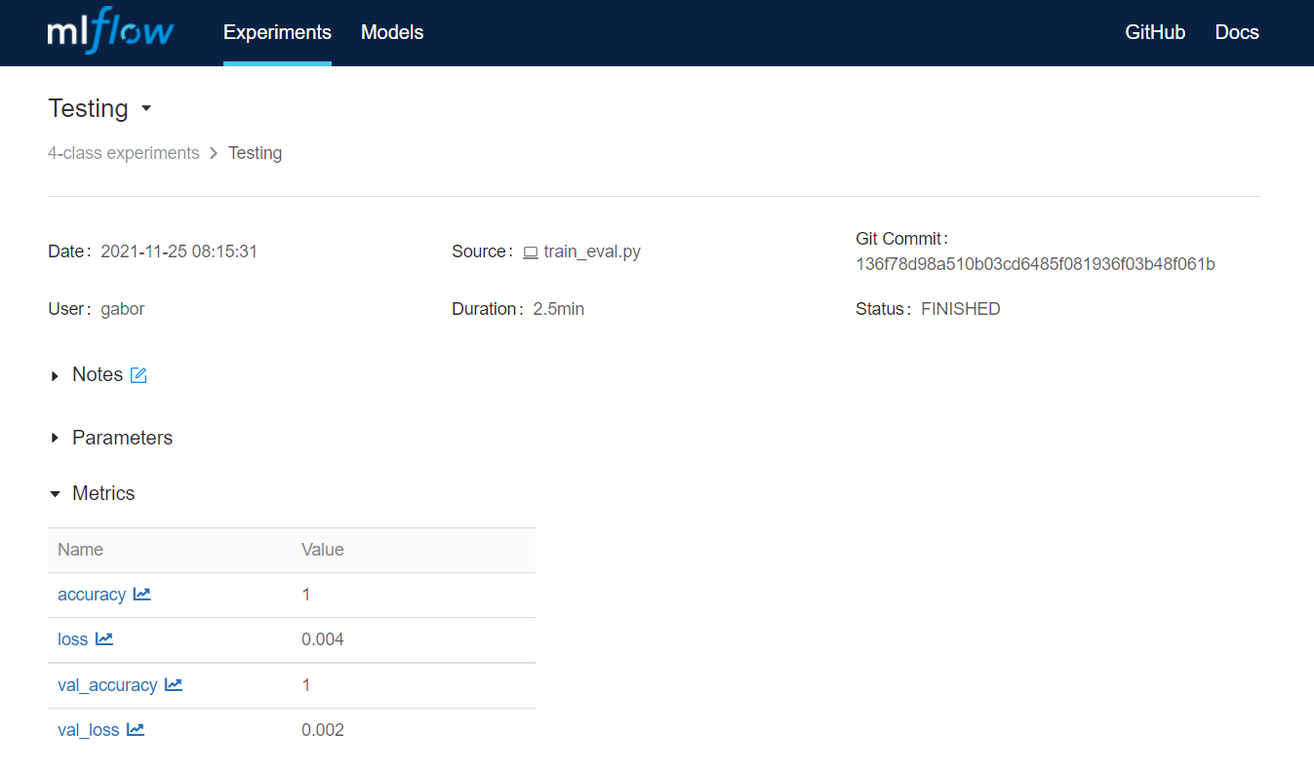
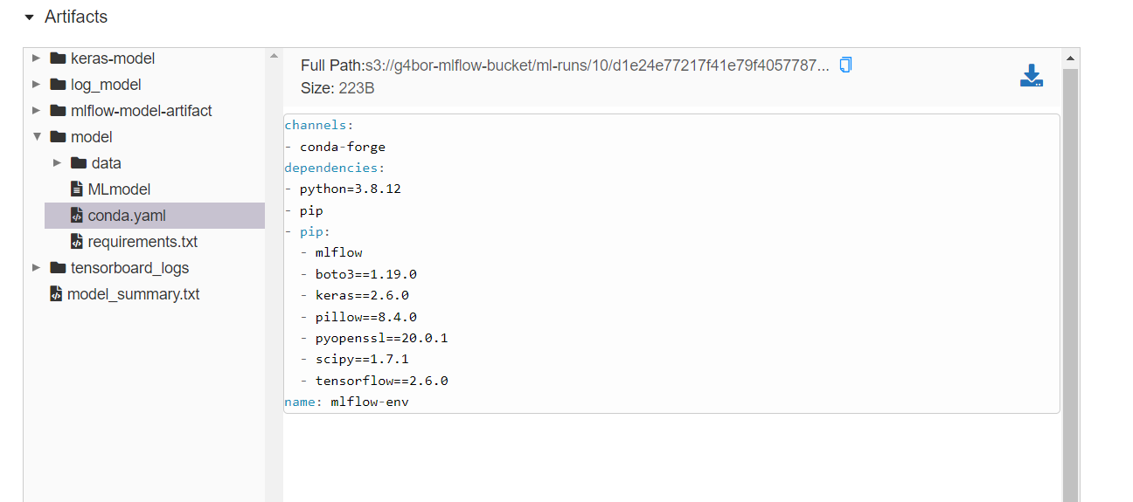
Experiment details – metrics & artifacts

Slide 17
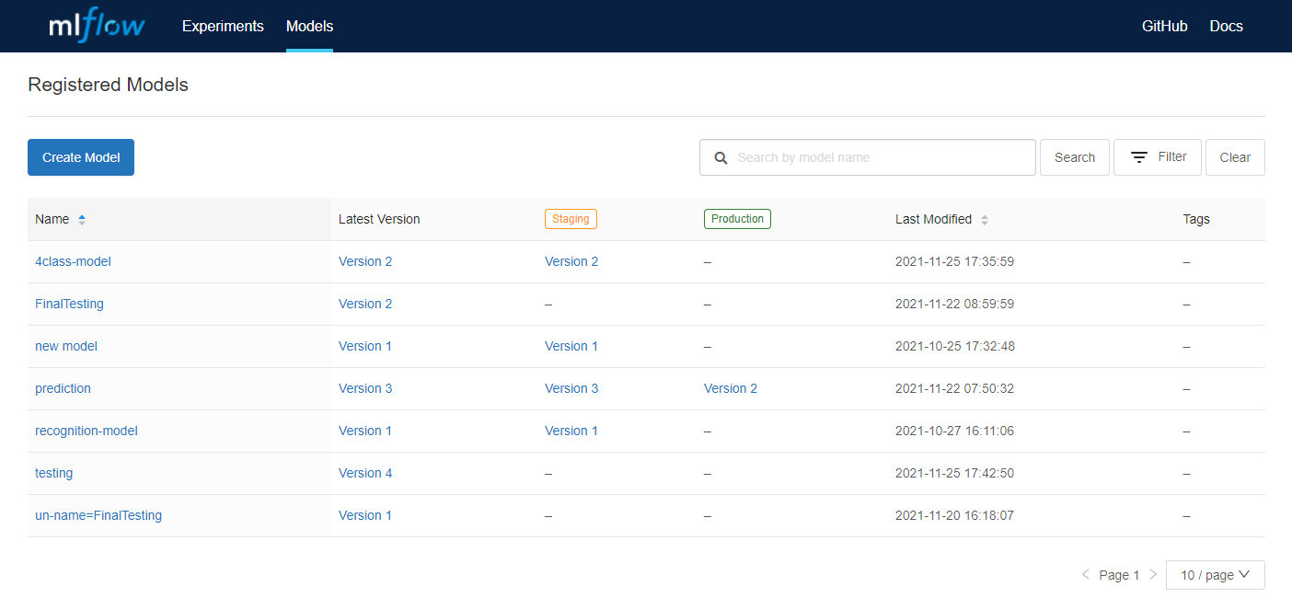
Tracking UI of MLflow – Model registry
Versions for each stage of the models
Registered models
Last version of the models
Notes:
All the registered models are listed, they can be filtered by tags and search by model name.
The latest version of the model and the version of each stage are displayed as well as the tags and the date of the last modification
A model can be created manually to use later to register an already been run model to it

Slide 18
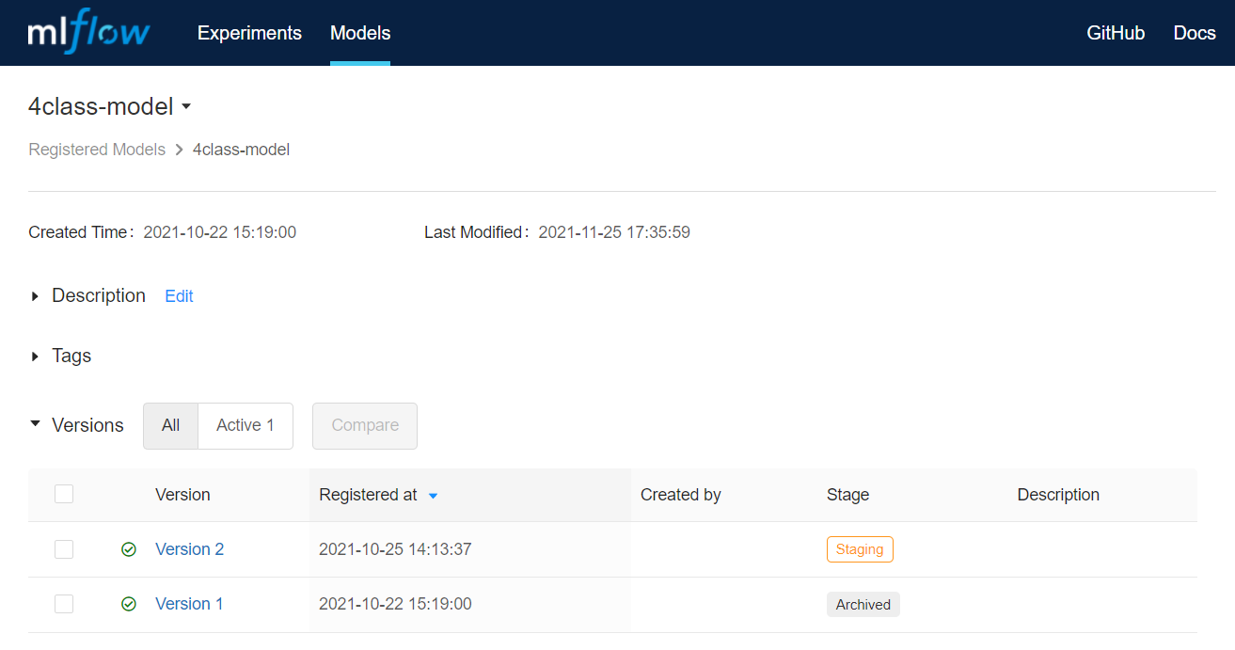
Tracking UI of MLflow – Details in Model registry

Slide 19
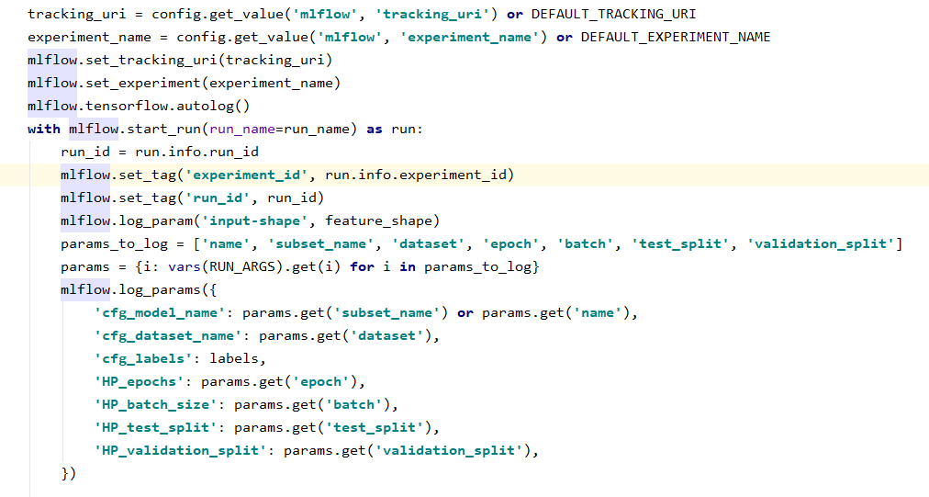
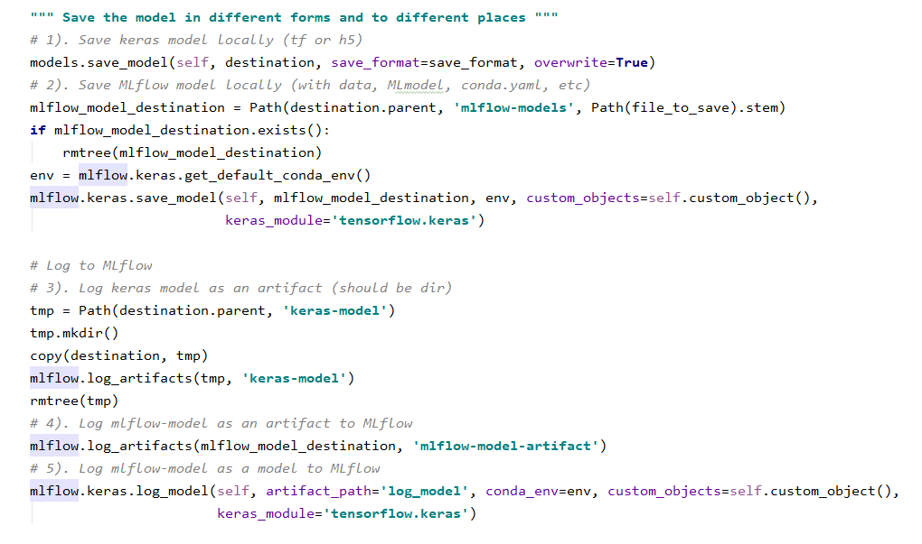
Utilize Mlflow Tracking API for logging

Slide 20
Summary
Solution
Learning curve
Customization & Documentation
Actively contributed open-source project
Pricing: Free, no feature limitations
Documentation has some shortcomings, but widely used so you can find help easily
Easy to setup and can be smoothly integrated into an existing code base as well
Highly customizable, ensure reproducibility of code executions

Slide 21
Questions & Answers

Slide 22
Special thanks to
Balazs Lehoczki
Norbert Parti
Robert Klajko

Slide 23


Thank you
gabor.tanacs@yahoo.com
github.com/1amG4bor/ mlflow-for-model-improvement

Slide 24
Additional contents

Slide 25
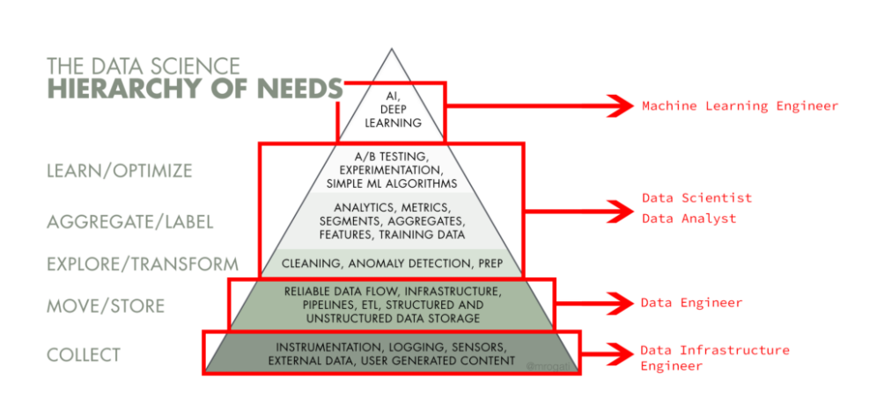
Hierarchy of the Data Process

Slide 26
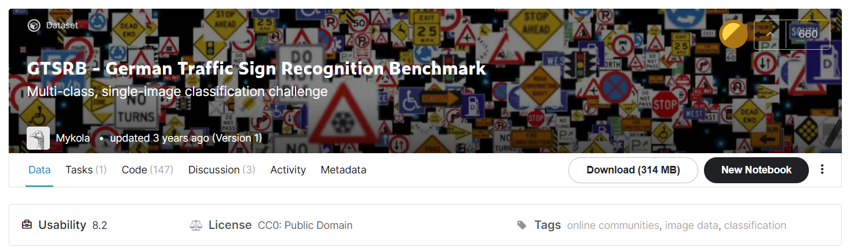
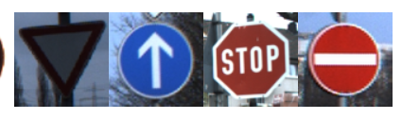
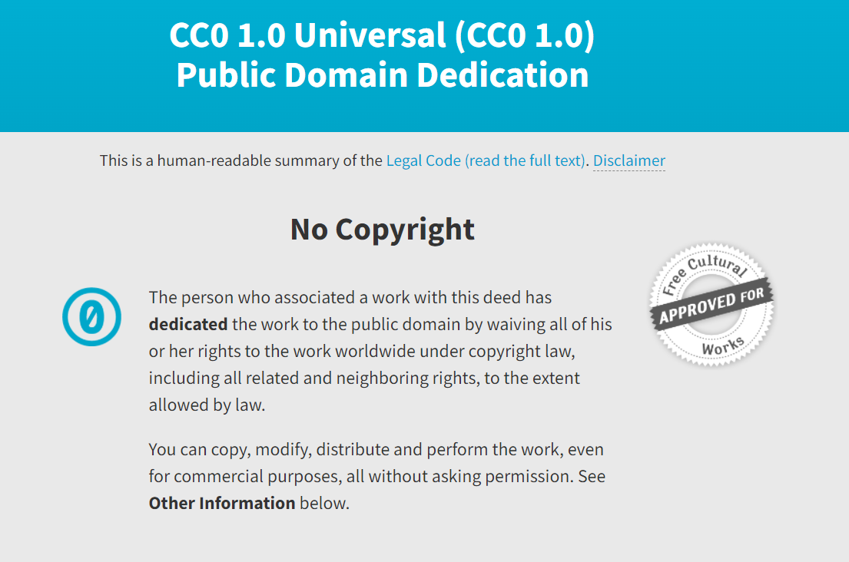

About the GTSRB on Kaggle
More about the dataset: https://benchmark.ini.rub.de/gtsrb_news.html
Notes:
Modifications: - The original dataset folders are renamed to indicate the class of traffic sign images thereby it can be used as labels in the training and validation process - Images are converted from `ppm` to `png` images

Slide 27


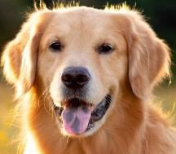
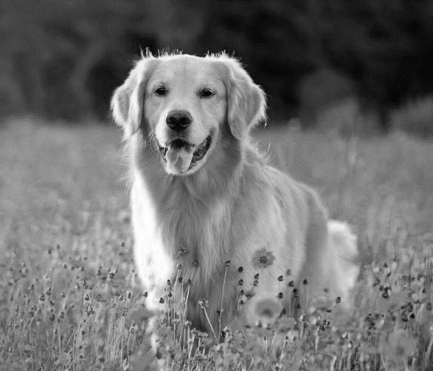
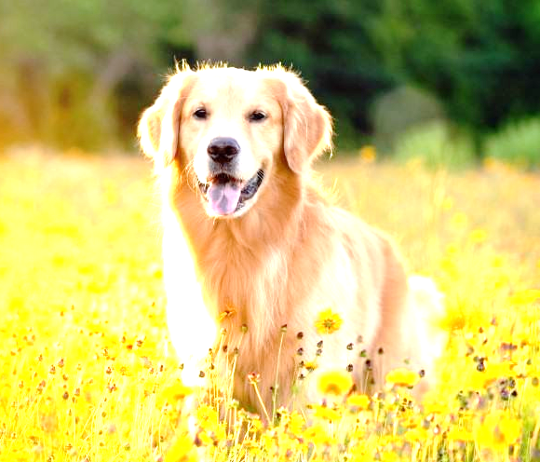
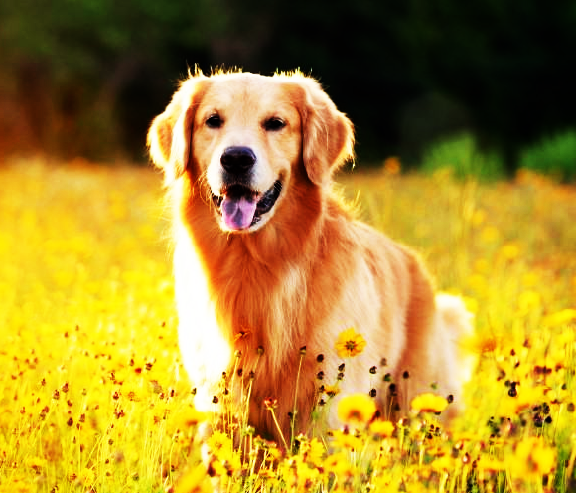
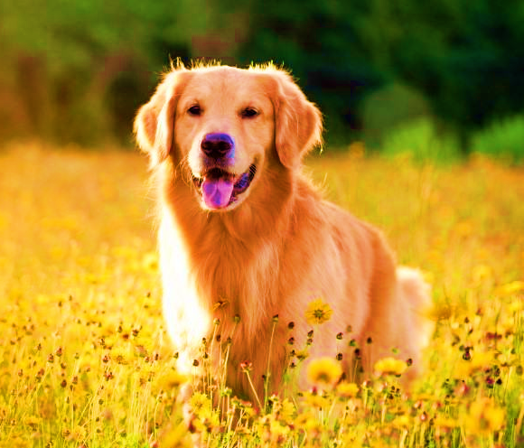

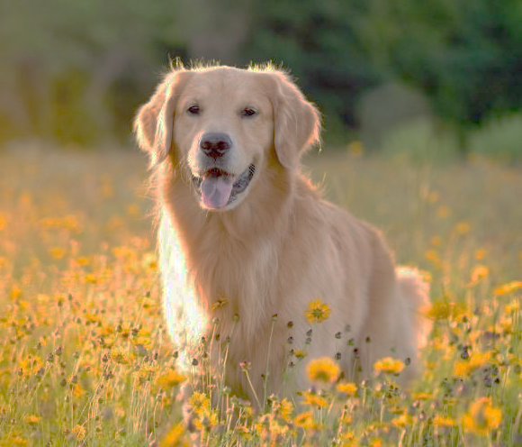


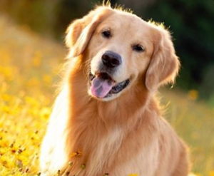
Data augmentation
Scaled to square
Cropped to square
Cropped (zoomed)
Saturation
Brightness
Contrast
Vertically flipped
Shifted
Blurred
Original image
Horizontally flipped
Rotated to right
Position augmentation
Color augmentation
Notes:
Data augmentation: extend the dataset with modified images to make the model more flexible
Position augmentation
Flipping – mirrored horizontally or vertically
Rotation – change the angle of the image
Scaling - resizing the image
Cropping - a portion of the image is selected
Translation/Shifting - moved either along the x-axis or y-axis
Color augmentation
Brightness - overall lightness or darkness
Contrast - difference between the highest and lowest intensity value
Saturation - depth or intensity of color
Hue - shade of the colors

Slide 28
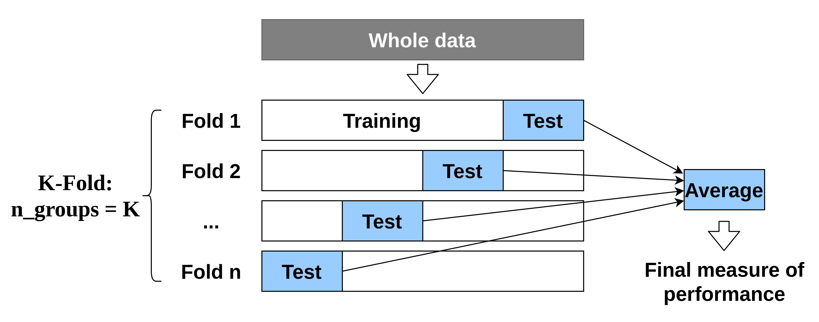
K-fold cross validation
Notes:
K-fold cross validation: resampling procedure used to evaluate machine learning models on a limited data sample

Slide 29
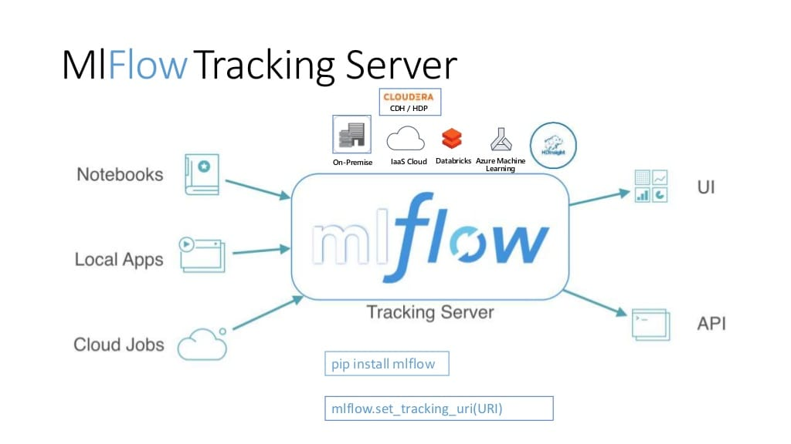
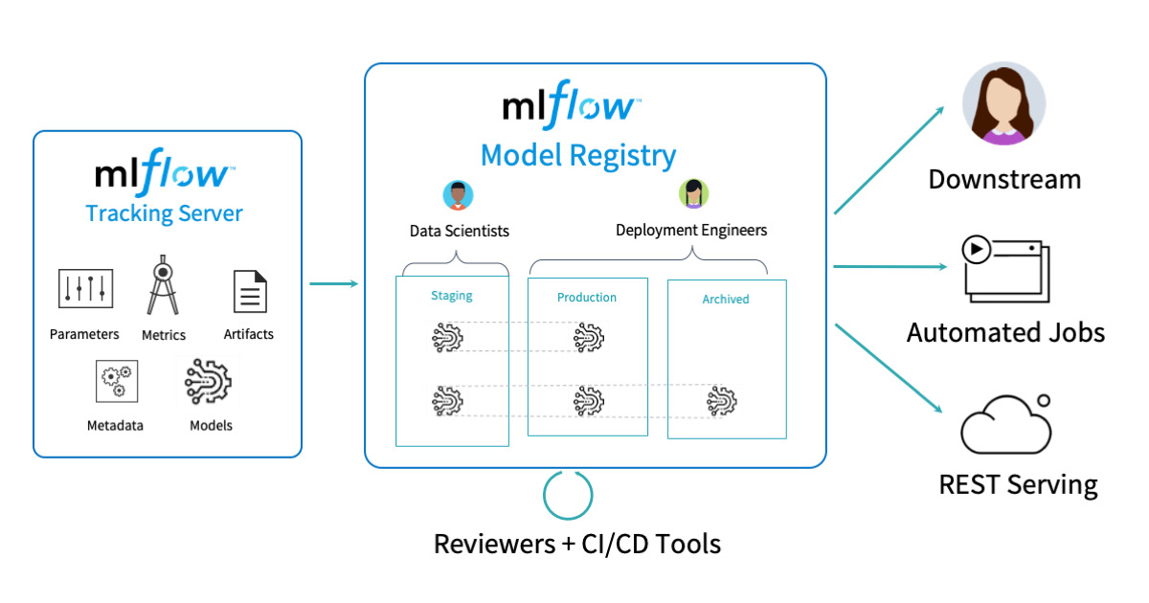
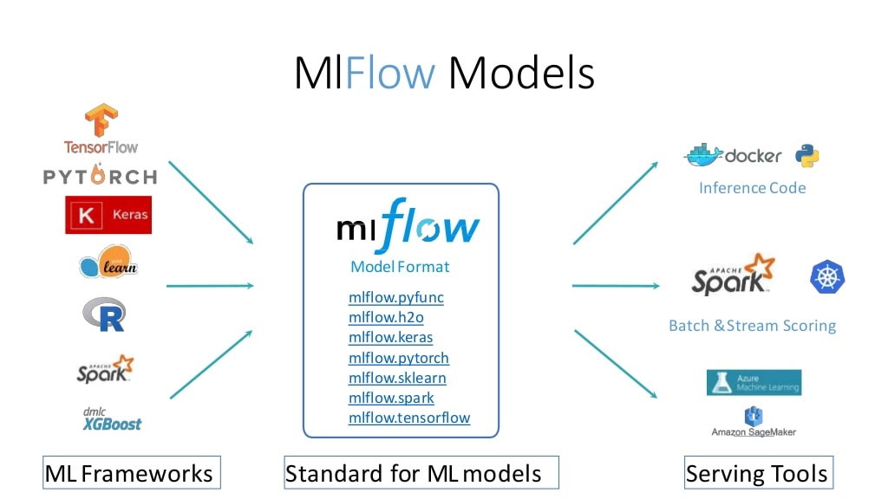
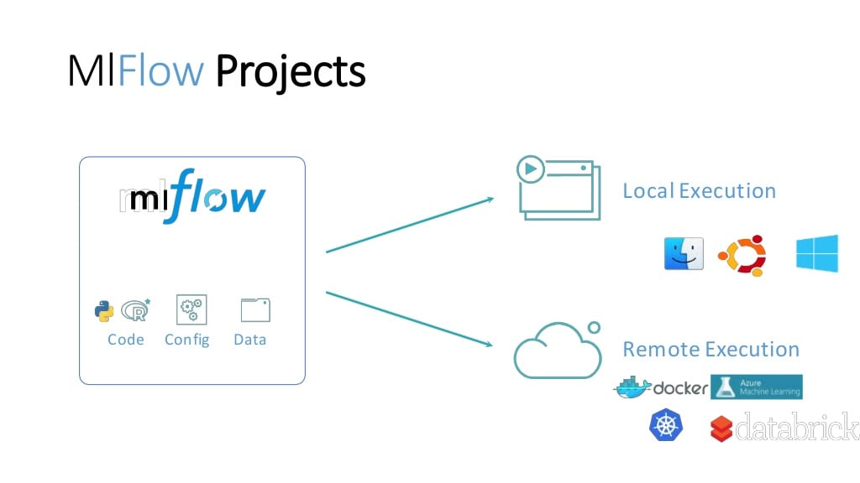
Notes:
MLflow diagrams about the behaviors and connections of components.

Slide 30
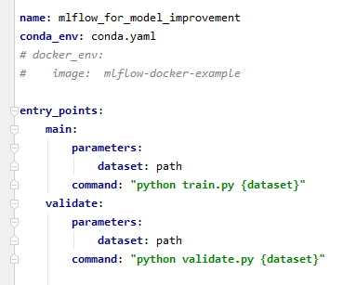
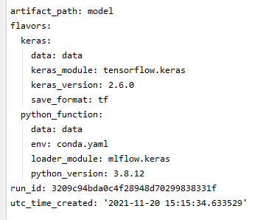
MLflow Projects
MLflow Models
Packaging format for reproducible ML runs Any code folder or GitHub repository with MLproject file
Defines dependencies for reproducibility
Execution API for running projects
Packaging format for ML Models Any directory with MLmodel file
Defines dependencies for reproducibility
Model creation and loading utilities mlflow.<flavor>.save/log/load_model(...)
Deployment APIs
mlflow run git@github.com:johndoe/my-project.git -P param_name=value
mlflow models serve/predict [OPTIONS [args]]
Notes:
MLflow Projects: Packaging ML code in a reusable, reproducible form in order to share with other data scientists, run on any platform or transfer to production. Need:
MLproject file
conda.yaml file
GitHub repository with the sources
MLflow Models: Managing and deploying models from a variety of ML libraries to a variety of model serving and inference platforms.
An MLflow Model is a standard format for packaging machine learning models that can be used in a variety of downstream tools. The format defines a convention that lets you save a model in different “flavors” that can be understood by different downstream tools.
Models: TensorFlow, Keras, PyTorch, Scikit-learn, Spark MLlib, etc.
Flavors: the format that helps the deployment tools to understand the model Environments: Docker, Apache Spark, Azure ML and AWS SageMaker, etc.
but MLflow provides deployment API & deployment CLI to deploy to custom targets and environments.

Slide 31

MLflow deployment targets
> Serve
Deploy on local machine as local Rest API
> Predict
Directly score files on local machine
> Build_docker
Package models to Docker images with Rest API endpoint
Deploy model on AWS or Azure
Deploy python_function models locally in a Docker container with compatible environment and remotely on AWS SageMaker or Azure ML
Rest API accepts
JSON-serialized pandas DataFrames
CSV-serialized pandas DataFrames
Tensor inputs as Numpy arrays
Export to Spark UDF
A python_function model can be an output as an Apache Spark UDF, which can be uploaded to a Spark cluster and used to score the model.

